Slide 1


SVNT Challenge

Slide 2

Problem Statement & Success Criterion
Using the data provided to design and develop a tool that forecast how popular the youtube video will be

Slide 3
Overview of the Team Idea
Input
Tags
Title
Description
Machine Learning Model
Output
Predicate Category
Probability of getting trend

Slide 4
Exploratory Data Analysis
Total no of rows & columns - 40949 rows & 16 columns
Average likes - 74266
Average dislikes - 3711
Average views - 2360784
Average comment count - 8446

Slide 5
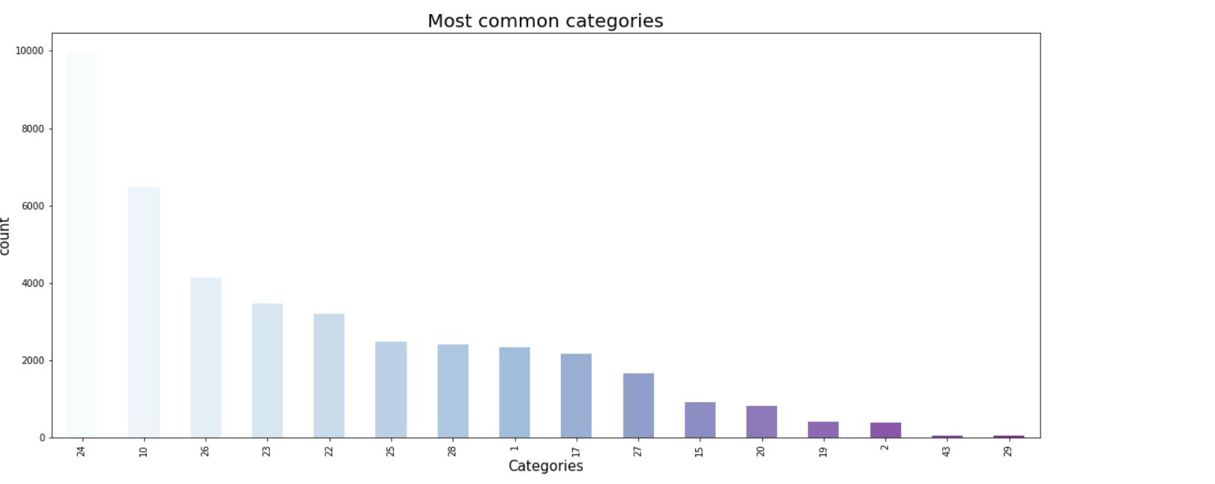
Data Visualization

Slide 6
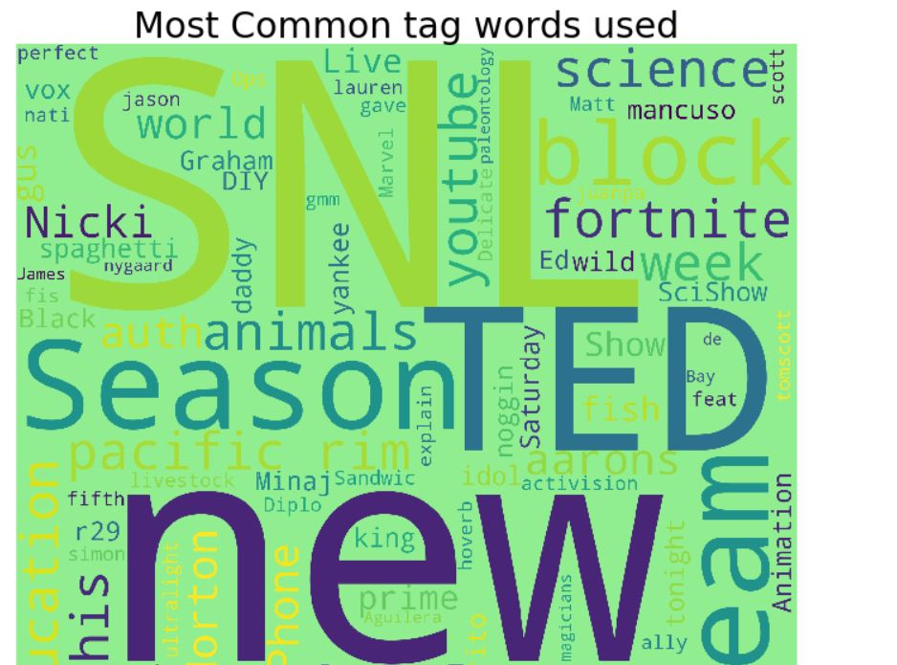
Data Visualization

Slide 7
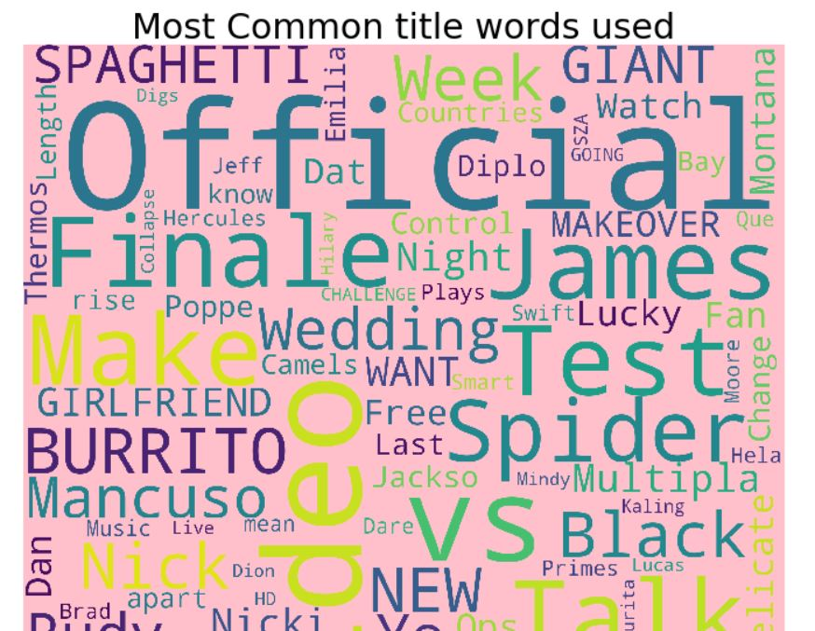
Data Visualization

Slide 8
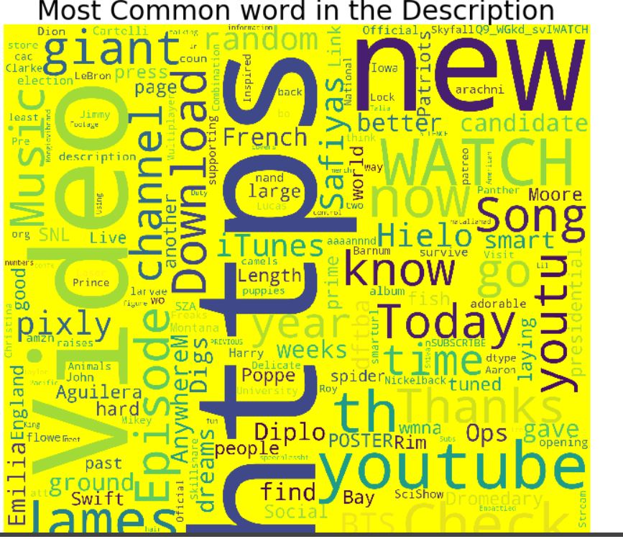
Data Visualization

Slide 9
Data Munging and Cleaning
I preprocesses the tags column with regular expression. I removed the name tags and emoticons

Slide 10
Training - Test split
I splitted the dataset into training and testing data (80:20)
Input Columns : Tags and Category

Slide 11
Model Selection
Before splitting the data, I converted the data into the vector form .
I used Support Vector Classifier model

Slide 12
Model Evaluation
F1 Score - 95.8%
Recall Score - 95.8%
Accuracy Score - 95.8%

Slide 13
Next Steps
Tune the model
Try different machine learning models
Evaluate the result on test data set
Do more data analysis
Data cleaning and munging

Slide 14
Thank you
Aakansha Neema

